Slide 1

Notes:
What is mental health?
Write in groups anything you know. Words, thoughts. No wrong/bad ideas.
We all have Mental health just as we all have Physical health

Slide 2



Poor physical health
Good physical health
Poor mental health
Good mental health
Diagnosed mental health illness

Slide 3
True or false quiz
Mental Health illnesses are contagious.
One in 10 children will experience mental health problems.
Only females can have a mental health illness.
Physical exercise can improve your mental health.
Listening to someone can improve their mental health.
We all have Anxiety.
Notes:
1) You cant catch a MH illness like you can catch a cold BUT spending long periods of time with someone who is experiencing poor mental health can affect your mood. Important you recognise how you are feeling each day. You need to look after your mental health just like you look after your physical health.
How do you look after your Physical health? Dentist, exercise, diet. Keep this in mind and we will come back to how to protect our mental health.
2) True, some research suggests this may be more- 1 in 8. Demonstrate with children holding up faces to visually show 1 in 10.
3) FALSE. Just as common in boys as in girls. Difficulty is boys show it in different ways, not so good at talking about it.
4) Whole group stand up. In their heads think of a number of how they are feeling right now. 1 being not happy 10 being fantastic. Instruct a series of on the spot activities for 5 minutes eg. Star jumps, squats, arm punches (have music as background). After 5 minutes ask group to re scale how they are feeling. How many have a higher number now?
5 ) TRUE. Often the best response is to listen. We have 2 ears and one mouth. Listen and then act.
Demonstrate good listening skills. Ask for a volunteer to come to the front. Ask them to start telling you about themselves, family, where they live etc. As they speak make it clear you are not listening- get name wrong, look at phone, talk to someone else. Ask group for feedback. Was a being a good listener? Why? What should I have done? Re demonstrate.
6) TRUE. Anxiety is normal. We need Anxiety to survive and keep us safe. It is our bodies clever way of making us feel uncomfortable, maybe butterflies in the stomach, feeling sick, dry throat. Hey, take notice. Fight or Flight. Think of the caveperson in a cave and a lion enters. Do you run from it, or fight it.

Slide 4










CORTISOL

Slide 5
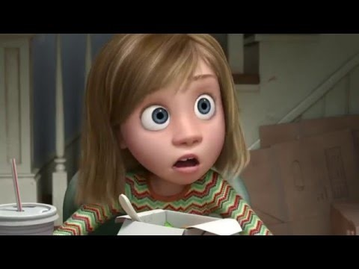
Notes:
Sometimes things happen in our lives and our emotions get a little bit too stirred up. Swirl bottle. Show film.

Slide 6

CORTISOL
CORTISOL
CORTISOL
Notes:
This can happen when we get really excited, unhappy, angry.
The cat is not happy with too much emotion.
The owl flies away because the strong emotions are too much for it . It is finding it too hard to make decisions, things can become bigger than they should, sometimes over react. The owl has stopped talking to the cat. Our calm, thinking brain has left us.
Cortisol is now flooding the brain, too much so the cat is getting stressed.
We want a healthy brain that manages when things in life go up and down. Demonstrate healthy and stressed brain with hand.
Stress bucket. Demonstrate visually (balls and bucket. Children write things that make them stressed on balls).
In groups things they can/cant control. Sort via hoola hoops.
Demonstrate with volunteers writing on balls what causes a YP to feel stressed, bucket becomes fuller, overflows. Sort into hula hoops things a YP can cant control.
Individuals do own stress bucket.
Circle things can control
What can help? What changes can they make to their life. Think back to how we look after our physical health. What can you do look after their mental health?
Being with friends, sport, talking, hobbies.
Calming techniques.

Slide 7
Notes:
Write in groups anything you now know. Words, thoughts. No wrong/bad ideas. Cross out anything you no longer agree with/think.

